Slide 1

Dual Enrollment Application Instructions
A step-by-step guide for completing the Dual Enrollment Application using Ga Futures.

Slide 2
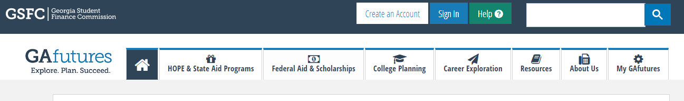
Step 1
Visit the GA futures website by going to www.gafutures.org
Have your student log in using their username and password
  If your student has forgotten their information, do not create a new account. Use the “forgot username” and “forgot password” options when selecting log in. If your student still cannot log in, have them contact their high school counselor.

Slide 3
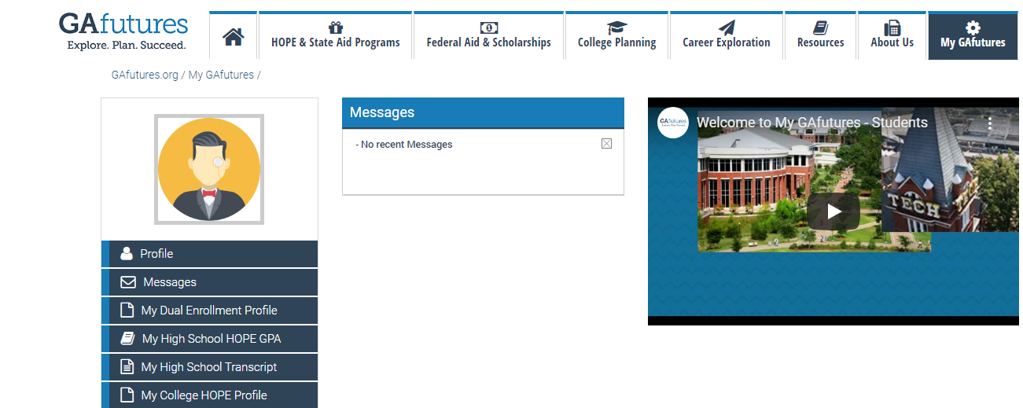
Step 2
  Once logged into the GA Futures website, your student should now see the homepage. Select “My Dual Enrollment Profile.”

Slide 4
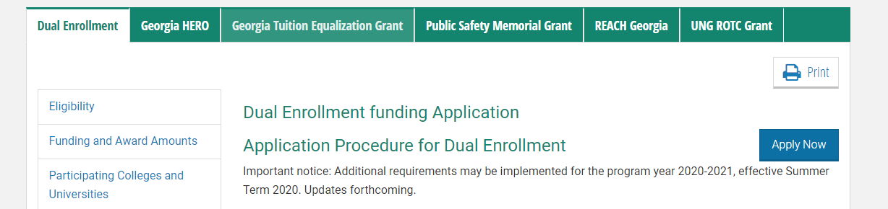
Step 3
  After entering the Dual Enrollment Profile page, please read through the important information. After reading the page, select “Apply Now.”
    If the application does not move to the next page, be sure your pop-up blocker is turned off. If you cannot move forward, try using a different browser such as Microsoft Edge or Firefox.

Slide 5
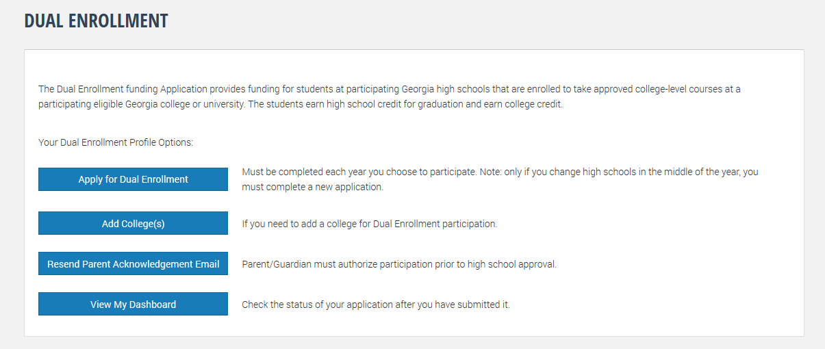
Step 4
  Next you will see the Dual Enrollment Profile Options. Begin with “Apply for Dual Enrollment.”

Slide 6
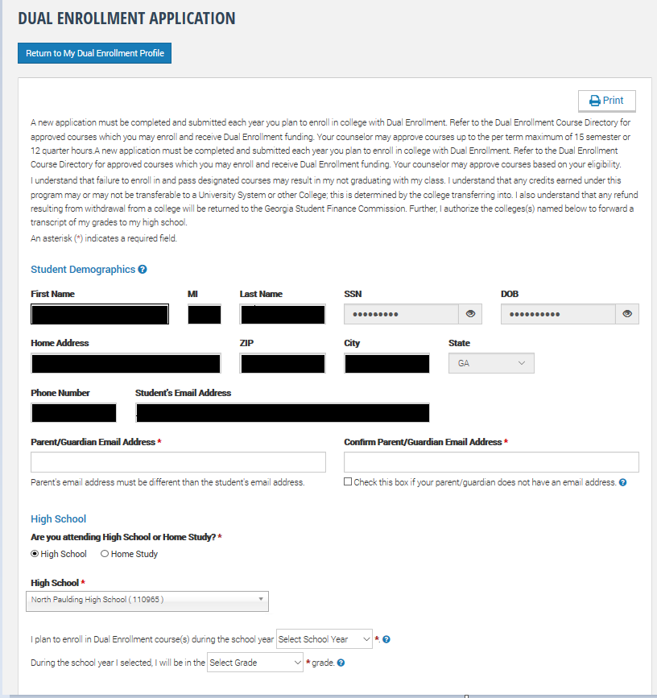
Step 5
  Most of your student's information will autofill based on the content your student entered when creating their Ga Futures account. If it does not, enter the correct information on the form below. If the form will not allow you to enter the information, you will need to return back to step 2, and select “profile” and update your student's information. All information must be accurate. The application will not process if the student's information does not align with the information the school has on file for your student.
    An email will be sent for parent authorization of this application. Be sure to enter a parent email address that can be checked by the parent/guardian.

Slide 7
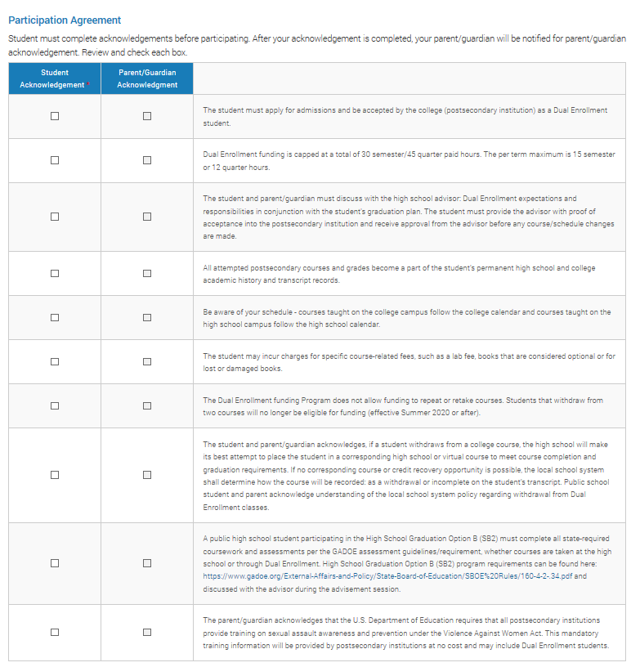
Step 5 Cont.
Next, read the participation agreement and select the “Student Acknowledgement” boxes when completed. Remember. You won’t be able to select the “Parent/Guardian Acknowledgement” on this screen. Your parent will be emailed instructions on how to log in and approve of this information.

Slide 8
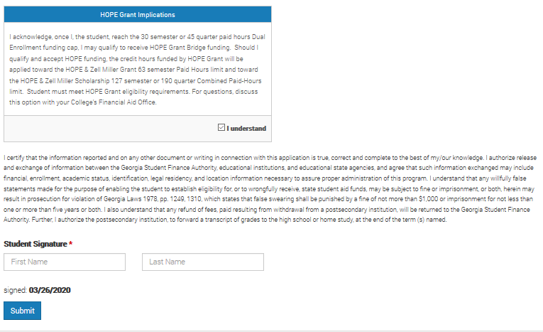
Step 5 Cont.
Read the “Hope Grant Implications” below the “Student Acknowledgement” box and select the “I understand box.”
Next, read the certification statement and sign your legal name on the document.
Click “Submit.”

Slide 9
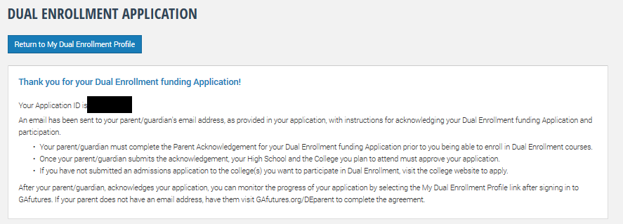
Step 6
Congratulations! Your Dual Enrollment Application is complete.
  Select “Return to my Dual Enrollment Profile.”
Be sure to write down your application ID. Your parent will need this to sign the Parent Participation Agreement Form.
  If you forget this step, your student can view their ID by logging into their GAFutures account and finding the “messages” tab. In the Messages, students will receive a copy of the application confirmation and application ID.

Slide 10
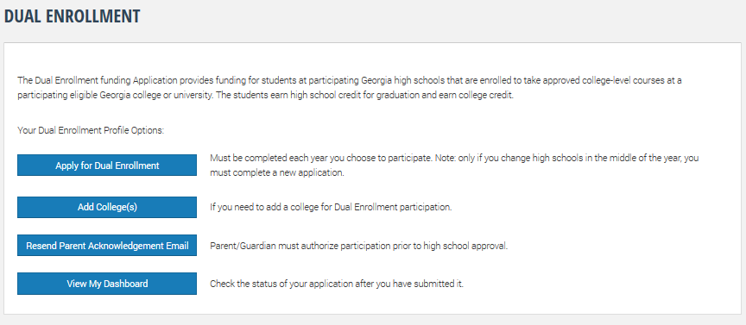
Step 7
Select the “Add Colleges” from your Dual Enrollment Profile.

Slide 11
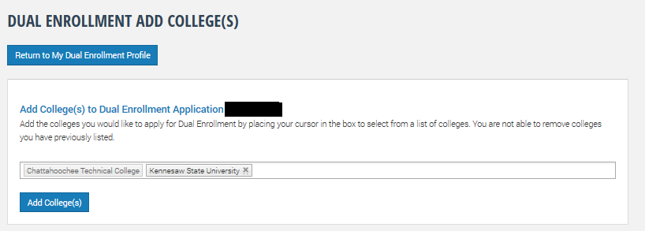
Step 8
Select the college you plan on participating in the dual enrollment program.
  You may select more than one college if you plan on dual enrolling at two different institutions.
When you’ve added the college(s), select “Add Colleges” for the information to save. Next, select “Return to my Dual Enrollment Profile.” This will automatically save and there is no submit button.

Slide 12
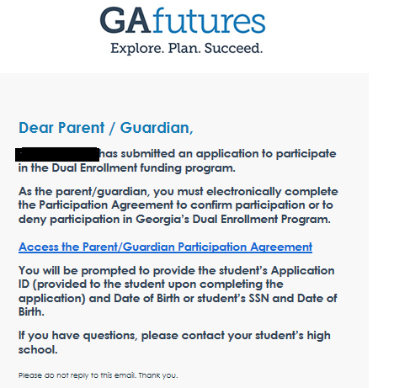
Step 9
Your Parent/Guardian will need to review your application and submit the Participation Agreement Form. Parent/Guardian will receive an email from noreply@gsfc.org to the email you designated in your application.
The email will look like the example below. The Parent/Guardian should select the link “Access the Parent/Guardian Participation Agreement.”

Slide 13
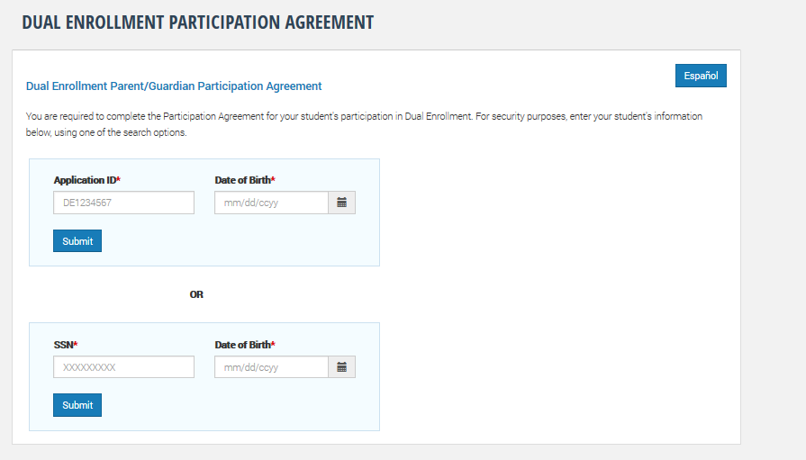
Step 9 Cont.
The parent/Guardian will need your Application ID or Social Security Number to move forward to the next step. Enter this information in the required box.
Once this information has been entered, select the “submit” button.

Slide 14
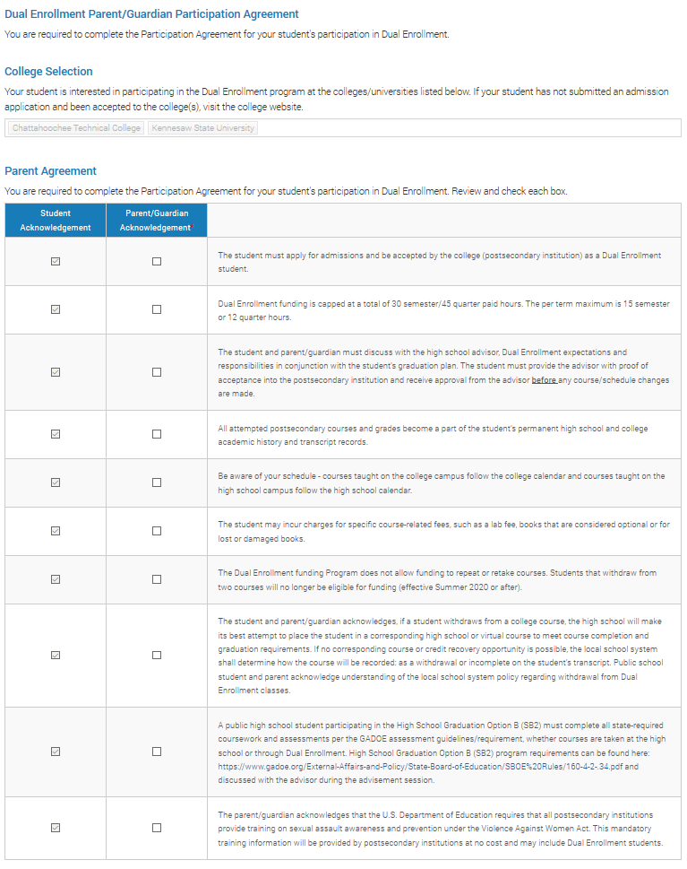
Step 9 Cont.
Next, the Parent/Guardian will read each section of the Participation Agreement form and check the required boxes.

Slide 15
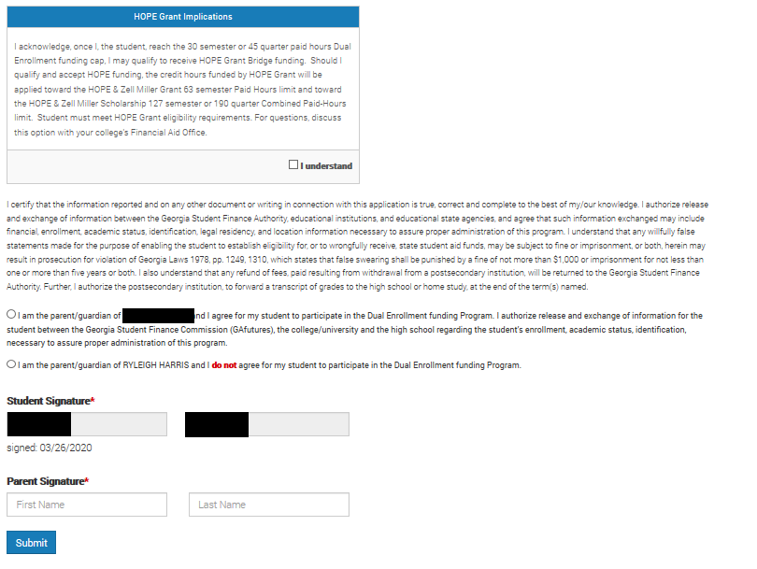
Step 9 Cont.
Next, the Parent/Guardian will read the Hope Grant Implications and check the “I Understand” box.
The Parent/Guardian will also need to read the certification statement, acknowledge consent, and sign electronically.
After the Parent/Guardian has completed these steps, select “submit.”

Slide 16
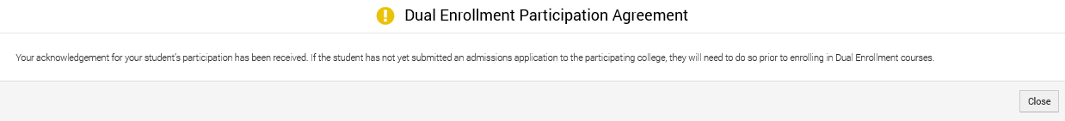
Step 9 Cont.
The Parent/Guardian will receive notification that the Participation Agreement has been received.

Slide 17
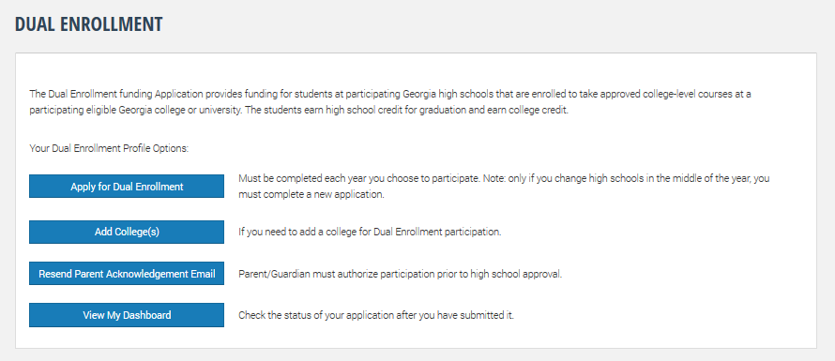
Step 10
The student may now log in and review their dual enrollment dashboard status.

Slide 18
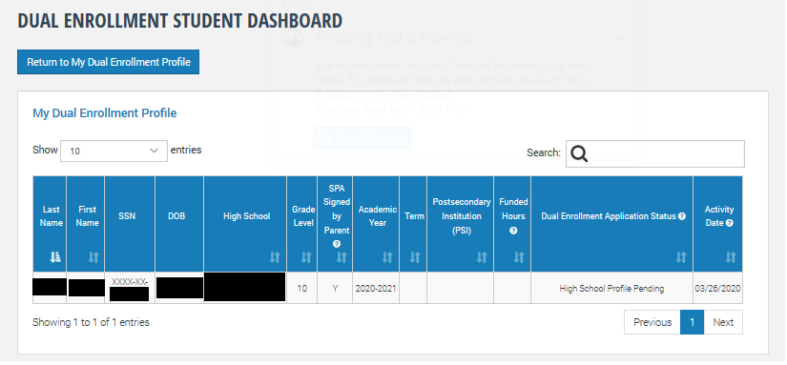
Step 10 Cont.
The student/parent participation agreement (SPA) and dual enrollment funding application are now complete!
Next Steps:
  Your high school counselor will approve of your application and funding after they have received a copy of your college schedule.
  District Documentation must now be completed, which will be online after June, 2020. (This was formerly on the “Form 1” document)
  Please email your high school counselor with any further questions that you have.

